Slide 1
A Shell Script to Monitor Linux Healthy
Network, Disk Usage, Uptime, Load Average and RAM Usage

Slide 2
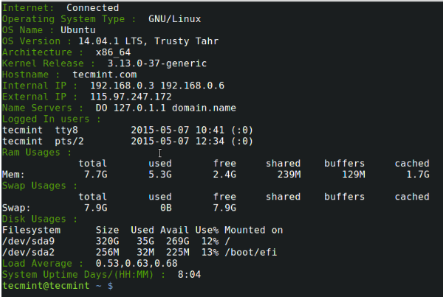
Get the script
# wget http://tecmint.com/wp-content/scripts/tecmint_monitor.sh
# chmod 755 tecmint_monitor.sh

Slide 3
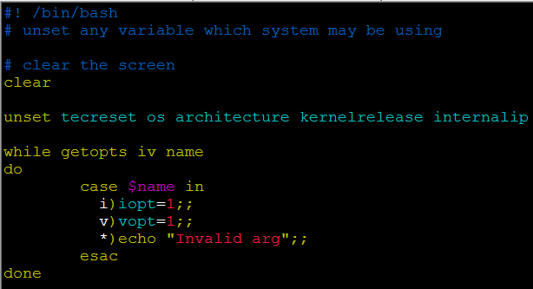
clear, unset
while ... do … done
getopts
./script.sh –i (echo $name -> i)
case ... in … esac

Slide 4
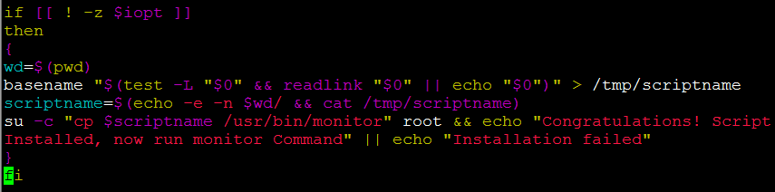
if … then … fi
-z option: empty string
test –L
readlink
basename
su –c

